Slide 1
Machine Learning

Slide 2
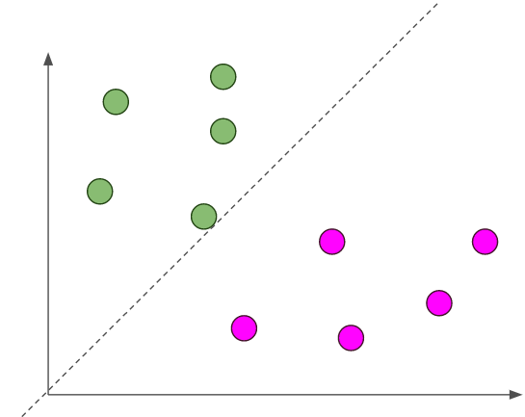
Classification
Now time to talk about the second part of supervised Learning which (Classification Problem)

Slide 3
Comparison between Regression & Classification
Regression take the input and try to fit output on continuous values.
With one variable called univariate linear regression.
With Multi variable called multivariate linear regression.
Regression take the input and try to fit output on discrete values.
With one variable that take on two values either 0 or 1 called binary classification problem.
With Multi variable that take on different values either 0 or 1 or 2 and so on called Multi classification problem.

Slide 4
Logistic Regression or (Classification)
First part of name doesn't make a sense, it's similar to name of Linear Regression !?
“But it also doesn't make sense for hθ(x) to take values larger than 1 or smaller than 0 since we need to map our values between 0 & 1 and actually take one value of them.”

Slide 5
Application of Classification
Spam Detection
Image Classification
Student Accepted or Rejected
Others

Slide 6
Log Function
Log_{C} A = B ---- That means C^{B} = A
Log 1000 = 3 !
Ln e = 1 !

Slide 7
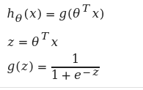
Sigmoid Function
We talk in previous about Hypothesis function which used to predict new values depends on input.
Previous equation of Hypothesis: y=mx + b
New equation of Hypothesis:
(Let's talk first about log and e)

Slide 8
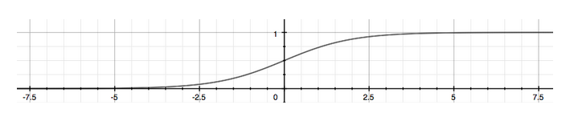
Sigmoid Function
The function g(z) maps our input to range between (0 & 1) as graph below it depends on value of z.
Using probability features we can map now instead of range to 0 or.

Slide 9
Probability
if hθ(x)=0.6, gives us a probability of 60% that our output is 1, that means
P(y=1|x,θ) and By complement theory P(y=0|x,θ) = 1 - P(y=1|x,θ).

Slide 10
Decision Boundary
What decision boundary make:
Depends on your specific threshold which will map any values returned from g(z) to 1 or 0 depends on this threshold you specify.
So h(x) = g(z) >= .5 that means X*theta >= 0,
From that we can conclude that:
Θ * x ≥ 0 then y = 1
Θ * x < 0 then y = 0
Let z = 0, then e⁰ = 1 and g(z) = ½
Let z = ∞, then e^{-(∞)} = very small number and g(z) Approximately to 1
Let z = -∞, then e^{-(-∞)} = very large number and g(z) Approximately to 0
The decision boundary is the line that separates the area where y = 0 and where y = 1. It is created by our hypothesis function.

Slide 11
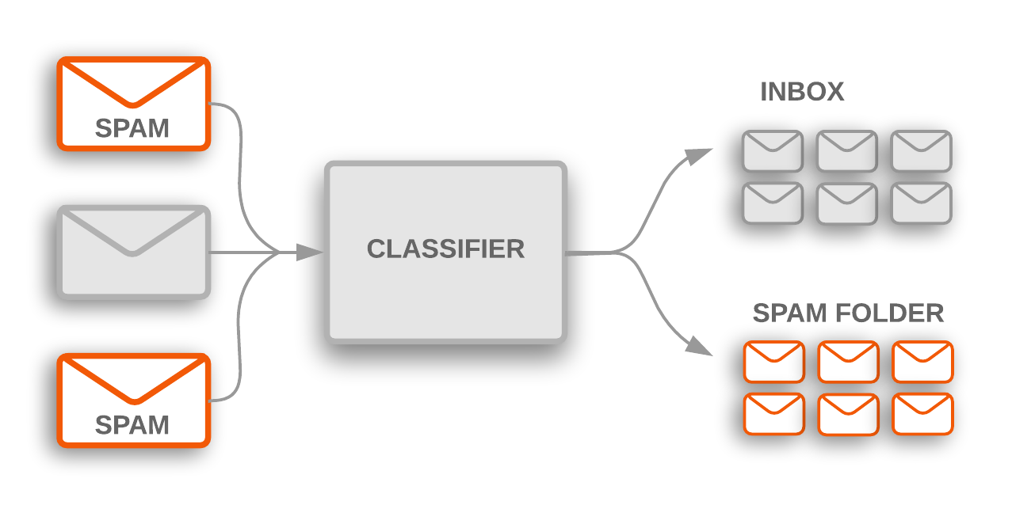
Binary Classification
One of the most binary classification problems is Spam classifier that map your emails to spam or inbox.

Slide 12
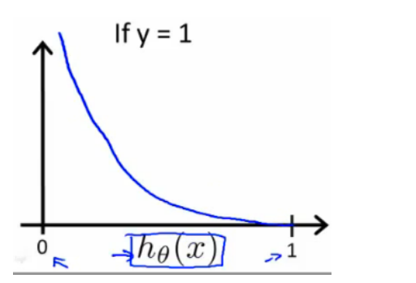
Cost Function
When y = 1, we get the following plot for J(θ) vs hθ(x).
hθ(x) = g(z) = 1/(1+e^{-z})

Slide 13
Cost Function
When y = 1, we get the following plot for J(θ) vs hθ(x).
hθ(x) = g(z) = 1/(1+e^{-z})

Slide 14
Conclude for Equations & graphs
If our correct answer 'y' is 0, then the cost function will be 0 if our hypothesis function also outputs 0. If our hypothesis approaches 1, then the cost function will approach infinity.
If our correct answer 'y' is 1, then the cost function will be 0 if our hypothesis function outputs 1. If our hypothesis approaches 0, then the cost function will approach infinity.
Cost(h_{θ}(x),y) = −log⁡(h_{θ}(x) ) =====>> if y = 1
Cost(h_{θ}(x),y) = −log⁡(1−h_{θ}(x)) ====>> if y = 0
Compressed Equation = Cost(h_{θ}(x),y)= −y log⁡(h_{θ}(x)) − (1−y) log⁡(1−h_{θ}(x))
If y = 1 then second part will be 0 which related to y = 0 and otherwise when y =0.

Slide 15


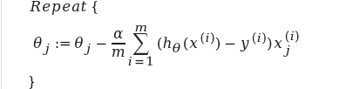

Cost Function & Gradient Descent Equations
We can fully write out our entire cost function for all data examples as:
A vectorized implementation of the cost function:
We can fully write out our entire Gradient Descent as:
A vectorized implementation of the Gradient Descent:

Slide 16
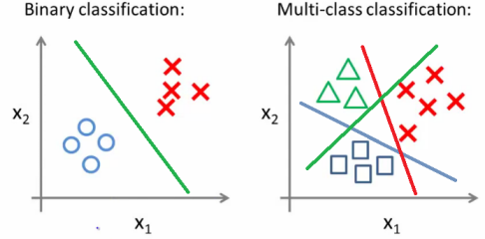
Multi Classification & OVA
Instead of just predict email is spam or not, its to predict it as spam or work email or social or promotions so its have been multi classification not binary as we saw. So Instead of y = {0,1} we will expand our definition so that y = {0,1...n}. n ⇒ Number of classes

